Slide 1
Unit 5
Network Programming with Java

Slide 2
Networking Basics
TCP
UDP
Port Number
IP Address

Slide 3
Transmission Control Protocol
TCP stands for Transmission Control Protocol.
It is a transport layer protocol that facilitates the transmission of packets from source to destination.
It is a connection-oriented protocol that means it establishes the connection prior to the communication that occurs between the computing devices in a network.
This protocol is used with an IP protocol, so together, they are referred to as a TCP/IP.
TCP is take the data from the application layer, divides the data into a several packets, provides numbering to these packets, and finally transmits these packets to the destination.
The TCP, on the other side, will reassemble the packets and transmits them to the application layer.
Since, TCP is a connection-oriented protocol, so the connection will remain established until the communication is not completed between the sender and the receiver.

Slide 4
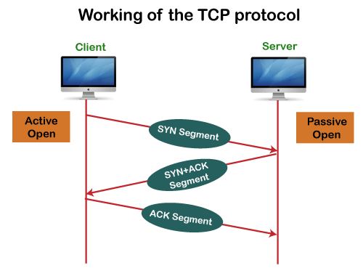

Slide 5
TCP VS UDP
KEY DIFFERENCES:
TCP is a connection-oriented protocol, whereas UDP is a connectionless protocol.
The speed for TCP is slower while the speed of UDP is faster
TCP uses handshake protocol like SYN, SYN-ACK, ACK while UDP uses no handshake protocols
TCP does error checking and also makes error recovery, on the other hand, UDP performs error checking, but it discards erroneous packets.
TCP has acknowledgment segments, but UDP does not have any acknowledgment segment.
TCP is heavy-weight, and UDP is lightweight.
When to use UDP and TCP?
TCP is an ideal choice, and even it has associated overhead, Therefore, when most of the overhead is in the connection, your application stays connected for any length of time.
UDP is ideal to use with multimedia like VoIP.
Use TCP sockets when both client and server independently send packets at that time; an occasional delay is acceptable. (e.g., Online Poker).
You should use user UDP if both client and server may separately send packets, and occasional delay is also not acceptable. (e.g., Multiplayer games).

Slide 6
Port Number
The port number is a unique number assigned to different applications.
For example, we have opened the email and games applications on our computer; through email application, we want to send the mail to the host, and through games application, we want to play the online games.
In order to do all these tasks, different unique numbers are assigned to these applications.
A port number is a unique identifier used with an IP address. A port is a 16-bit unsigned integer, and the total number of ports available in the TCP/IP model is 65,535 ports. Therefore, the range of port numbers is 0 to 65535. In the case of TCP, the zero-port number is reserved and cannot be used, whereas, in UDP, the zero port is not available. IANA (Internet Assigned Numbers Authority) is a standard body that assigns the port numbers.

Slide 7
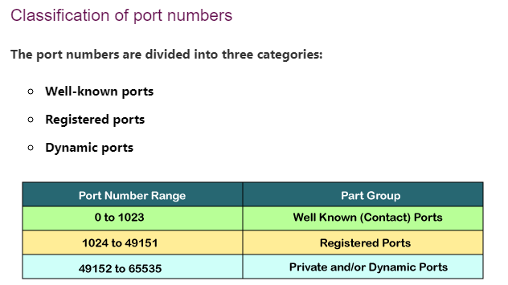
Port Number | Usage
20 | File Transfer Protocol (FTP) Data Transfer
21 | File Transfer Protocol (FTP) Command Control
22 | Secure Shell (SSH)
23 | Telnet - Remote login service, unencrypted text messages
25 | Simple Mail Transfer Protocol (SMTP) E-mail Routing
53 | Domain Name System (DNS) service
80 | Hypertext Transfer Protocol (HTTP) used in World Wide Web
110 | Post Office Protocol (POP3) used by e-mail clients to retrieve e-mail from a server
119 | Network News Transfer Protocol (NNTP)
123 | Network Time Protocol (NTP)
143 | Internet Message Access Protocol (IMAP) Management of Digital Mail
161 | Simple Network Management Protocol (SNMP)
194 | Internet Relay Chat (IRC)
443 | HTTP Secure (HTTPS) HTTP over TLS/SSL

Slide 8
What is Socket?
A Socket is an endpoint of a two way communication link between two programs running on the network.
The Socket is bound to a port number so that TCP Layer can identify the application that data is destined to be sent.
Client Port
Server Port
Connection

Slide 9
Socket Programming in Java
Java Socket Programming is used for communication between the application that is running on different JRE.
It can be either connection oriented or connection less.
Socket and ServerSocket classes are used for connection-oriented socket programming.
DatagramSocket and DatagramPacket classes are used for connection-less socket programming.
The client in socket programming must know two information:
  IP address of Server
  Port Number.

Slide 10
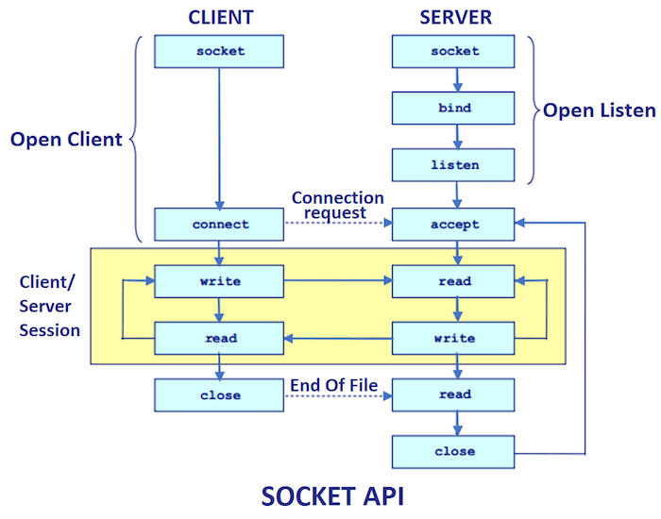

Slide 11
TCP Socket (Client and Server Side)
Creating Server:
ServerSocket ss=new ServerSocket(6666);
Socket s=ss.accept();//establishes connection and waits for the client
Creating Client:
Socket s=new Socket("localhost",6666);

Slide 12
Socket/ServerSocket Classes
Method | Description
1) public InputStream getInputStream() | returns the InputStream attached with this socket.
2) public OutputStream getOutputStream() | returns the OutputStream attached with this socket.
3) public synchronized void close() | closes this socket
Socket class
A socket is simply an endpoint for communications between the machines. The Socket class can be used to create a socket.
ServerSocket class
The ServerSocket class can be used to create a server socket. This object is used to establish communication with the clients.
Method | Description
1) public Socket accept() | returns the socket and establish a connection between server and client.
2) public synchronized void close() | closes the server socket.

Slide 13
MyServer.java
import java.io.*;
import java.net.*;
public class MyServer {
public static void main(String[] args){
try{
ServerSocket ss=new ServerSocket(6666);
Socket s=ss.accept();//establishes connection
DataInputStream dis=new DataInputStream(s.getInputStream());
String str=(String)dis.readUTF();
System.out.println("message= "+str);
ss.close();
}catch(Exception e){System.out.println(e);}
}
}

Slide 14
MyClient.java
import java.io.*;
import java.net.*;
public class MyClient {
public static void main(String[] args) {
try{
Socket s=new Socket("localhost",6666);
DataOutputStream dout=new DataOutputStream(s.getOutputStream());
dout.writeUTF("Hello Server");
dout.flush();
dout.close();
s.close();
} catch(Exception e){System.out.println(e);}
}
}

Slide 15
UDP Socket

Slide 16
public class UdpServer {
public static void main(String[] args) {
try {
DatagramSocket ds = new DatagramSocket(3000);
byte[] buf = new byte[1024];
DatagramPacket dp = new DatagramPacket(buf, 1024);
ds.receive(dp);
String str = new String(dp.getData(), 0, dp.getLength());
System.out.println(str);
ds.close();
} catch (Exception e) {
System.out.println("Error");
}
}
}

Slide 17
public class UdpClient {
public static void main(String[] args) {
try {
DatagramSocket ds = new DatagramSocket();
String str = "Welcome java";
InetAddress ip = InetAddress.getByName("127.0.0.1");
DatagramPacket dp = new DatagramPacket(str.getBytes(), str.length(), ip, 3000);
ds.send(dp);
ds.close();
} catch (Exception e) {
System.out.println("Error");
}
}
}

